Slide 1
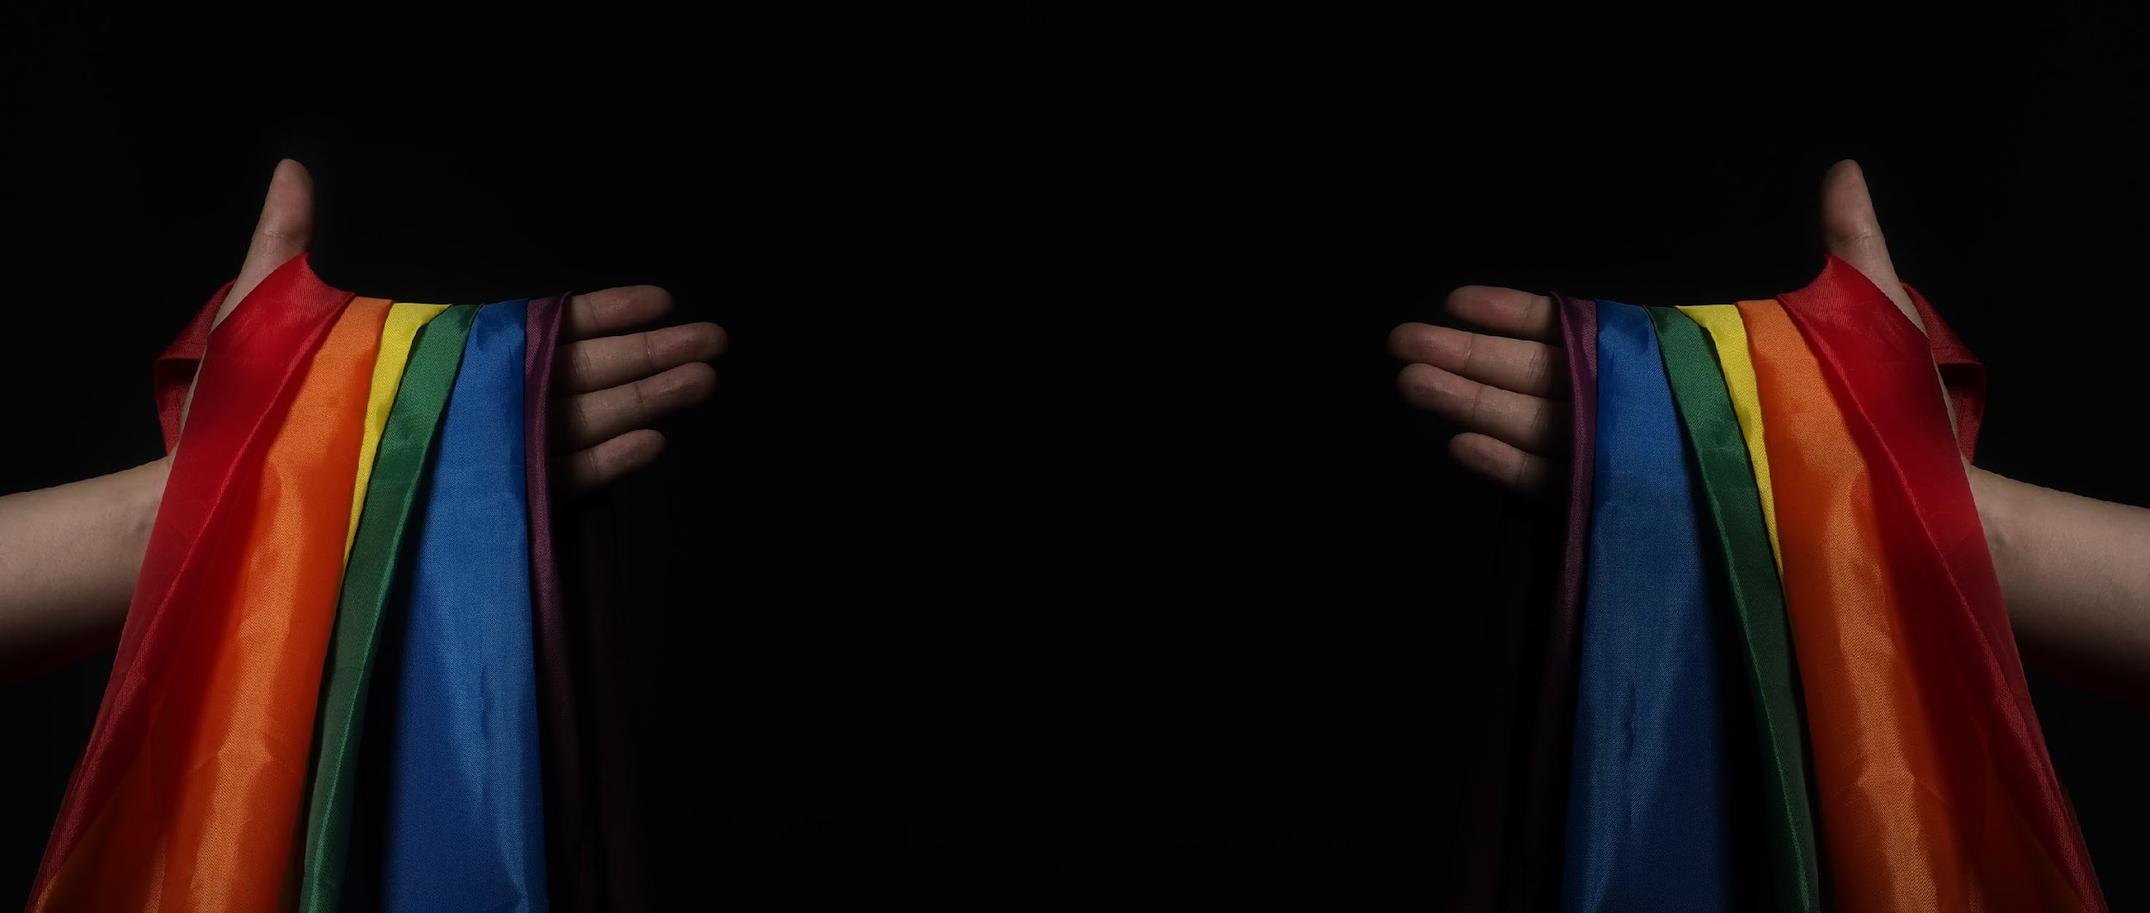
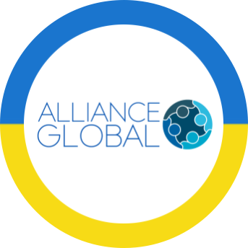
REPORT
on the provision of emergency assistance
for 2023

Slide 2


WHAT DOES ALLIANCE.GLOBAL DO?
ALLIANCE.GLOBAL is a national public organization that has been operating since 2002, created and managed by representatives of LGBTIQ+ communities to improve the quality of life and health of LGBTIQ+ people.
For more than 2 years of the armed conflict, ALLIANCE.GLOBAL has been providing the following types of services for LGBTIQ+ people who have found themselves in difficult life circumstances as a result of the war:
                shelters for LGBTIQ+ people in Kyiv, Kharkiv, Dnipro, Lviv and Chernivtsi;
                services based on "safe spaces"/community centers for LGBTIQ+ people in difficult life circumstances due to the war in Lviv, Poltava, Cherkasy, Kharkiv, Dnipro, Chernivtsi, and Odesa;
                multi-purpose emergency cash assistance in all non-occupied territories;
                wide range of humanitarian aid: food and hygiene vouchers or kits, clothing/ shoes, communication equipment, etc;
                individual and group psychological assistance, as well as psychiatric consultations and assistance in purchasing medications that improve mental health;
                professional development/retraining courses for those LGBTIQ+ people who have lost or are looking for a job;
                legal/paralegal assistance and medical consultations;
                "peer-to-peer" counseling and social support to other resocialization programs to social and medical institutions, HIV/AIDS, viral hepatitis and STI prevention and treatment programs based on our organization, etc.

Slide 3
During 2023, 24,275 LGBTIQ+ people and their families received assistance through ALLIANCE.GLOBAL, and a total of 27,595 different services were provided.
Of these:
9,833 LGBTIQ+ people and their household members received various types of cash assistance;
169 people received temporary shelter in our shelters;
4,454 LGBTIQ+ people received food packages or vouchers;
3,370 people received hygiene kits or vouchers;
874 people received psychological assistance;
674 people received clothes/shoes;
82 persons received emergency medical consultations;
4,562 persons received paralegal or legal aid;
a total of 565 different group awareness-raising events were held in community centers and/or shelters;
257 people received means for connection and light (power banks, flashlights) during this period.

Slide 4
The total number of services received by clients of ALLIANCE.GLOBAL during 2023

Slide 5
Services received by clients in Kyiv during 2023

Slide 6
Services received by clients in Lviv during 2023

Slide 7
Services received by clients in Chernivtsi during 2023

Slide 8
Services received by clients in Dnipro during 2023

Slide 9
Services received by clients in Kharkiv during 2023

Slide 10
Services received by clients in Poltava during 2023

Slide 11
Services received by clients in other regions of Ukraine during 2023

Slide 12
Number of people who received food vouchers during 2023

Slide 13
Number of people who received hygiene vouchers during 2023

Slide 14
Number of people who received paralegal / legal aid during 2023

Slide 15
Number of people who received psychological consultations during 2023

Slide 16
Number of people who received medical consultations during 2023

Slide 17
Number of people who found refuge in the shelter in 2023

Slide 18
Number of information and educational events held in 2023

Slide 19
Multifunctional cash assistance for LGBTIQ+ people and their household (HHs) members*

Slide 20
Number of people who received quick individual financial aid during 2023

Slide 21
Number of people who received clothing / shoes during 2023

Slide 22
Number of people who received PowerBanks during 2023

Slide 23
Number of people who received flashlights during 2023

Slide 24

Our contacts and online resources
E-mail: aid@ga.net.ua
Facebook https://www.facebook.com/AllianceGlobalKyiv (English language page)
Instagram: https://www.instagram.com/alliance.global
X (ex-Twitter): https://twitter.com/AlGlobalKyiv (English language page)
LinkedIn: https://www.linkedin.com/company/alliance-global-public-organization
YouTube: @AllianceGlobalUA
Web: http://ga.net.ua/en; https://www.mentalk.com.ua/; https://lgbti-consortium.org.ua/; https://paralegals.com.ua/; https://prep.com.ua/; https://gettest.com.ua/; https://long.prep.com.ua/
Local pages:
In Instagram: Kharkiv, Poltava, Dnipro, Lviv, Chernivtsi, Kyiv, Cherkasy, Odesa
In Facebook: Kharkiv, Poltava, Dnipro, Lviv, Chernivtsi, Kyiv, Cherkasy, Odesa

